Slide 1
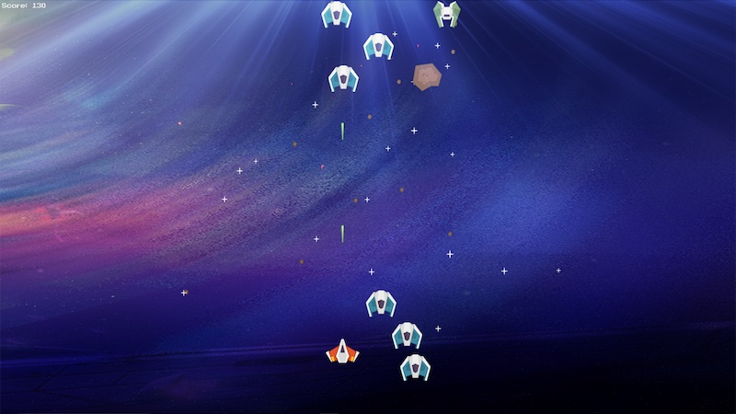
Asteroid Space Game
Dylan McGarity | Daniel DiRoberto
Dodge space rocks to beat the high score!
http://arcade.academy/examples/asteroid_smasher.html

